Slide 1


DIET MANAGEMENT APP
A HEARTFUL INTRODUCTION TO BALANCED EATING HABITS
AUTHOR: VALARY AYUMA
DATE: 18TH SEPTEMBER 2024

Slide 2


PROBLEM STATEMENT
The Problem:
Increasing rates of obesity and dietary-related illnesses globally.
Lack of awareness about nutritional values and healthy eating.
Significance:
Addressing these issues can lead to improved health outcomes and reduced healthcare costs.
Aligns with global health initiatives and supports sustainable diet practices.

Slide 3

SOLUTION OVERVIEW
Diet Tracker offers a user-friendly platform where individuals can log their meals, track nutrient intake, and receive reminders about dietary limitations. Additionally, it provides sustainability tips to promote environmentally conscious eating habits. User-friendly interface built with flutter for both iOS and Android platforms.

Slide 4

BENEFITS FOR USERS
By utilizing Diet Tracker, users can simplify their meal tracking, adopt healthier eating habits, minimize food waste, and cultivate a mindset of sustainability, all while staying informed about their dietary choices.

Slide 5

FEATURES
Our application boasts several key features such as secure registration, meal logging, expiration alerts, sustainability tips.

Slide 6

USER JOURNEY
The user journey is designed to be intuitive. Users register, log in, and begin logging meals, receiving valuable insights throughout the process.

Slide 7
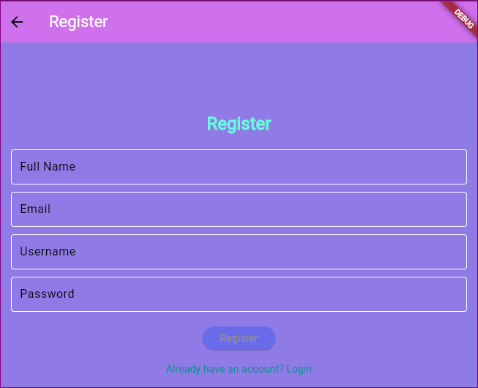
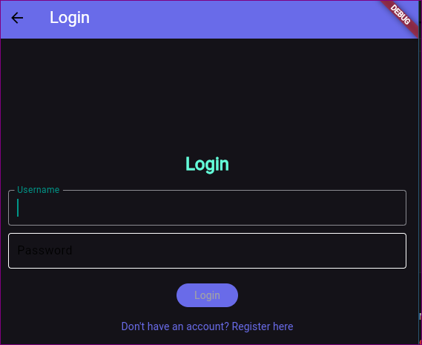
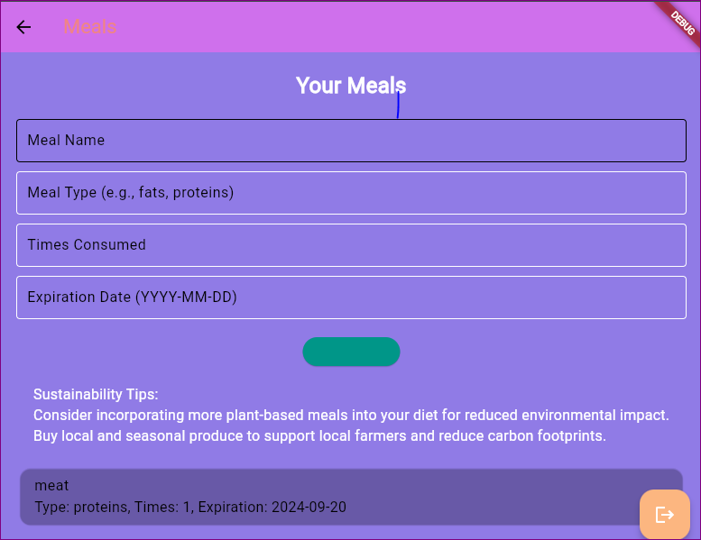
DESIGN MOCKUPS
Let’s take a look at the application in action. Here are some screenshots showing user registration, meal logging, and the alert system that informs users about their dietary choices.

Slide 8
TECHNICAL STACK
Diet Tracker is built using a modern technology stack that is dart with flutter for cross-platform compatibility and smooth performance.

Slide 9

MARKETING STRATEGY
We plan on implementing a freemium model, allowing users access to basic features for free while offering premium subscriptions for more advanced tools. Additional revenue can come from targeted advertisements and affiliate marketing.

Slide 10

JOIN US IN PROMOTING HEALTH
Join Us and be part of promoting healthier lifestyles!
Contact Information;
Email: valaryayuma03@gmail.com
Contact: +254 757 184 454.
Thank you for your time! We believe Diet Tracker can transform how we approach dietary health. If you have any questions or feedback, please feel free to reach out.

